Slide 1
Classroom Management Bumps Responding to Challenging Behaviour
Adapted from Classroom Management, Bennett & Smilanich (1994)

Slide 2
Effective Classroom Environments
Content
Instructional Strategies
Instructional Skills
Classroom Management

Slide 3
Goals of misbehaviour.
Attention seeking
Power/defiance
Revenge (physical or emotional)
Assumed disability (low self confidence/self esteem)

Slide 4
What effects our decision to respond?
Past behaviour of the student
Severity of misbehaviour
Frequency of misbehaviour
Time between misbehaviours
Importance of lesson
School discipline policy
Student’s life at home
Student’s respect for the teacher
Reaction by allies

Slide 5
Pre-empt where possible.
Win students over
Greet at the door
Show interest
Be polite
Be alert

Slide 6
Bump 1 Low key responses
Proximity
Student’s name
Gesture
“Look”
Pause
Ignore
Use signals (for attention)
Deal with problem, not the student

Slide 7
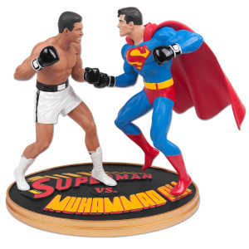
Bump 2 Squaring off
Five steps
Pause/stop
Turn towards student
Intensify eye contact
Minimal verbal request to stop
Finish with a thank you

Slide 8
Bumps 3 and 4 Choices and the implied choice

Slide 9
Bump 3
Stop, square off, make eye contact
Provide the student with an appropriate choice
Ask for an answer
Listen to the answer
Finish with a thank you.

Slide 10
Bump 4
If the student persists follow through with the other side of the choice.
“You’ve made your decision. Please …

Slide 11
Attributes of Effective Choices
Choice is related to misbehaviour
The choice is not seen as a punishment
The consequence is given as immediately as possible
The choice is not an ultimatum
Use a positive or neutral tone
Don’t bluff, follow through on the choice

Slide 12
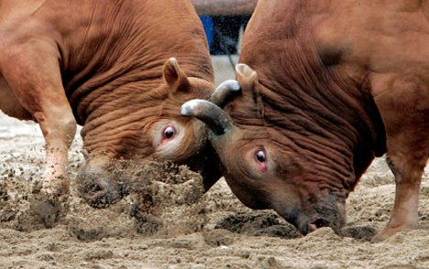
Bump 5 Defusing the power struggle

Slide 13
Bump 5 Defusing the power struggle
Stop, square off, make eye contact (2-3s)
Take one or more deep breaths
Deal with any allies
Shift the locus of control
Pause and allow the student to save face
Closure by saying thank you.

Slide 14
Responses to power situations
Ignore it
Short circuit it
Describe the situation and inform the student you are not interested
Put ball back in student’s court
Provide a choice
Student leaves the class

Slide 15
Bump 6 Informal Agreement
Greet student and set atmosphere
Define problem
Generate alternatives
Agree on alternatives to try and when to begin
Review what has been agreed upon
End conference positively

Slide 16
Bump 6 Informal Agreement
Shifts the responsibility to the student
Minimises the time spent dealing with misbehaviour during class time
Allows student and teacher to work together
Opportunity to establish a more positive relationship

Slide 17
Bumps 7, 8, & 9
Formal contracts
In-school suspensions
Out-of school suspensions
A collective response by staff and parents to assist the student to take action about whether or not to be part of that school’s learning environment

